Slide 1
objective
Identify the diversity of information sources and resources and when to use them.
Identify a variety of publication formats in which information is presented/ or communicated.

Slide 2
Information Sources
Your choice of sources depends on the task at hand.
Questions to Ask:
What information sources do I need? i.e. books, articles, etc.
Or Information resources do I need? Databases, search engines-Google, library catalogue etc.
In the next section, we shall focus on the types of information sources .

Slide 3
Type of Information Sources
You can think of information in terms of…
1. Primary sources
2. Secondary sources
3. Tertiary sources
Information sources can be regarded as primary or secondary depending on their:
Originality
Proximity to the source or event

Slide 4
Information Sources
Why bother to distinguish between types of sources?
Distinguishing between types of sources enables critical evaluations to be made about the information. When information is four or five times removed from the source, it is easy for detail to be lost or ideas misinterpreted.
For example, scholarly research is based on primary sources because it generates more accurate and efficient research.

Slide 5
Primary Sources
They are those sources that are closest to the actual event, time period, or individual in question.
They are original materials which have not been filtered through interpretation.
Original = Primary = First
Primary sources are factual; they are not analyzed or interpretated.

Slide 6
Characteristics of Primary Sources
Original, first-hand account of an account or time period.
Written or made during or to the time of the event.
Information that has not been edited, interpreted or condensed.

Slide 7
Examples Of Primary Sources
Report of scientific discoveries
Results of experiments
Results of clinical trials
Original creative writing or works of art
Political and social sciences research results
Patents
Statistics, interviews, observations, surveys, memoirs, and transcripts of speeches
Autobiographies, diaries and original writing

Slide 8
Cont……
Newspaper articles (when written at the time of an event), and works of literature
Artifacts such as furniture, buildings, tools and clothes
Photographs, music and artwork
Legislation and law reports
Novels, poems, plays
Letters, e-mails, memos, blogs
Parliamentary papers and debates

Slide 9




Secondary Sources
Secondary sources analyze, interpret and comment on primary information sources
Not original = Secondary = Not first.
Second-hand account of events.
Analyzes and interprets creative works, research results, and scientific discoveries.
Notes:
Note: Your need for primary or secondary sources will depend on the assignment you have been given.
You may be directed to use only primary sources for your assignments or both primary and secondary sources

Slide 10
Examples Secondary Sources
Biographies
Journal articles (when they report or summarize the findings of others)
Books (when the material is drawn from other work and intended as a topic overview or summary
Technical reports, conference proceedings
Newspaper articles that analyze events
Edited videotapes and audiotapes, handbooks, databases
Literature reviews

Slide 11
Tertiary Sources
Tertiary sources consist of information which are distillation and collection of primary and secondary sources
They are indexes and/or textual condensation of primary and secondary sources
Usually with references back to the primary and secondary sources
Examples:
Almanacs
Bibliographies
Chronologies
Dictionaries
Directories
Encyclopedias
Guidebooks
Indexes
Abstracts

Slide 12
Composite Examples
Subject | Primary Source | Secondary Source | Tertiary Source
History | Colonial days diary | Book on Independence struggles | List of Colonial Governors
Literature | A novel or poem | An essay about themes in the work (a novel or poem) | Bibliography of literature
Political Science | A Political Party Manifesto | An article about formation of a Party | A chronology of participation in elections
Art | A painting | A critical review of the painting | An encyclopedia article on the artist

Slide 13

Reference Sources
Reference sources provide access to:
Background to introductory information
Topic overviews
Definitions
Collections of facts
Statistics and tables of data
Paths to other sources of information
Reference sources usually have the same features as Tertiary sources of information.

Slide 14
Reference Sources
They can be very good for finding factual information quickly. Be aware that the titles of reference sources may be misleading. For example, dictionaries may be called encyclopaedias and vice versa
They can help you to find actual information or used to find additional information sources, e.g. indexes, bibliographies etc.

Slide 15
Characteristics of Reference Sources
Authoritative materials from which information can be obtained
They are usually subject specific
Include reference books, records from library catalogues, general or subject specific indexes.
Meant for consultation for a specific piece of information.

Slide 16
Characteristics of Reference Sources
Not meant for continuous reading.
A reference source may consist of disjointed entries of varying length
They may be brought together mainly by virtue of alphabetization – lack continuous exposition.
In libraries, usually not lent out.
The entries are well-organized to afford easy location of required information.

Slide 17
Reference Sources - Examples
Source | Definition | Uses | Examples
Abstracts | A summary of an article or paper, often appearing at the beginning of the paper. An abstract field may also be available in some indexes. In business proposals and other documents It is also referred to as the Executive Summary | Find a summary of a journal article on a particular topic and a citation to the full work | Criminal Justice Abstracts Ceramic Abstracts

Slide 18
Reference Sources - Examples
Source | Definition | Uses | Examples
Almanacs | An almanac contains facts of a miscellaneous nature and quite often includes statistical information relating to countries, personalities, events, subjects and the like. Often published on an annual or regular basis. | provides statistics, lists, figures, tables and specific facts in a variety of areas Confirm a date, fact or figure | The World Almanac and Book of Facts The Encyclopedia Britannica Almanac The World Almanac and Book of Facts 2007

Slide 19
Reference Sources - Examples
Source | Definition | Uses | Examples
Atlases/ Maps | A collection of maps providing geographical and/or spatial information. Also a collection of detailed illustrations of human anatomy | To locate places around the world. Gather information about demographics of a region, physical features or distance between locations Find a map or detailed illustrations of human anatomy. | The Times Atlas of the World Google Maps Apple Maps Ghana Post GPS Atlas of the Human Body

Slide 20
Reference Sources - Examples
Source | Definition | Uses | Examples
Biographical sources | A collection of essays and profiles of people's lives written, composed, or produced by another. | Find personal profiles | Who’s Who Dictionary of National Biography

Slide 21
Reference Sources - Examples
Source | Definition | Uses | Examples
Bibliographies | There are two meanings. Firstly, a list comprising (a) works cited in the text; and (b) other relevant works consulted. Other names for the list included ‘References’, ‘List of References’, or ‘Sources Consulted’. Secondly, a publication that consists of a list of books, articles etc. on a particular subject. | Find additional materials on a topic | The New Cambridge bibliography of English Literature. Architecture: a bibliographic guide to basic reference works, histories, and handbooks.

Slide 22
Reference Sources - Examples
Source | Definition | Uses | Examples
Catalogues | A list of itemized display of titles, course offerings, or articles for exhibition or sale. Usually including descriptive information or illustrations. The most common type of catalogue used is the Library catalogue. | Used to search through the complete collection of a library, shop, etc | UEW Library Catalogue WINNOPAC Catalogue of drawings by old masters

Slide 23
Reference Sources - Examples
Source | Definition | Uses | Examples
Dictionaries | Dictionaries are sources that deal primarily with all aspects of words from proper definitions to spellings. Usually have an alphabetical listing of words There are general dictionaries as well as subject-specific ones. | used for a quick search of a word or a topic to find meaning, spelling and pronunciation also include information on parts of speech or word form and word origin | The Oxford English Dictionary Longman’s Dictionary of Contemporary English Collins English Dictionary Dictionary of Accounting Terms Dictionary of Ga-English Dictionary Dictionary of Music

Slide 24
Reference Sources - Examples
Source | Definition | Uses | Examples
Directories | The ALA Glossary of Library Terms defines a directory as “a list of persons or organizations, systematically arranged, usually in alphabetical or classed order, giving addresses, affiliations and so forth…” They include telephone, fax numbers, e-mail addresses and other pertinent information | Used to find names and addresses of people, organizations, institutions, companies, etc. | The Directory of Exceptional Children Ghana Telecom Telephone Directory Who’s who in the West The WORLD of Learning Africa A-Z Continental and Country Profiles Medical and Health Information Directory The Internet Directory

Slide 25
Reference Sources - Examples
Source | Definition | Uses | Examples
Encyclopa-edias | A work containing informational articles on subjects in every field of knowledge. They can be general, or subject-specific. Usually arranged in alphabetical order. Collection of detailed articles on a wide range of subjects. Reputed to be the single most-used sources of information. | Typically used to find background information on a subject. | World Book Encyclopedia The Encyclopedia Britannica Encyclopedia of Educational Technology The Cambridge Encyclopedia of Language The Cambridge Encyclopedia of Africa

Slide 26
Reference Sources - Examples
Source | Definition | Uses | Examples
Handbooks/ Manuals | Handbooks are much the same as manuals they are the “how-to-do-it” side of ready reference questions provide concise data, usually in table or chart form, on a specialized subject area constitute a useful reference for finding current statistics, procedures, instructions or specific information on a topic. | A useful reference for finding current statistics, procedures, instructions or specific information on a topic. | Ghana 1977: an Official Handbook Guinness World Records Manual for Writers of Term Papers, Theses and Dissertations MLA Handbook for Writers of Research Papers Publication Manual of the American Psychological Association

Slide 27
Reference Sources - Examples
Source | Definition | Uses | Examples
Indexes | An index is something that serves to guide, point out, or otherwise facilitate reference, especially an alphabetized list of names. An index can be found at the end of a single-volume reference work or non- fiction book In multi-volume reference books indexes are usually compiled as a separate volume and subject specific | A list that can be used to find information within a source | Back of the book index Africa: a guide to reference material Current Index to Journals in Education Education Index Social Science Index Wilson Humanities Index

Slide 28
Reference Sources - Examples
Source | Definition | Uses | Examples
Thesaurus | The term Thesaurus means “treasury”, a “store” or “hoard.” Also means a book of synonyms, near synonyms, antonyms, phrases and slang terms for words. A thesaurus can be arranged alphabetically or by idea or concept. | Helps find words to express an idea for which you want to find a different or an opposite word. | American Heritage Thesaurus for Learners of English Thesaurus of English words and phrases Webster’s students Thesaurus Political Science Thesaurus

Slide 29
Reference Sources - Examples
Source | Definition | Uses | Examples
Year Books and annuals | An annual collection of facts, photographs or statistics often limited to a particular country or subject discipline | First statistical data | Year Book of Sports Medicine Advertising Yearbook Year Book of Traditional Music The CIA World FactBook

Slide 30
Publication Formats

Slide 31
Types of Publication Formats
Information is published in a variety of formats.
It is important that you are aware of the range of formats available to you and know how to select and use those appropriate for your assignment.
For example:
Journals
Books
Grey Literature
Audio-visual materials
Conference proceedings
Theses/ Dissertations
Web pages
Legislation
Electronic Resources

Slide 32

Books (monographs)
Offer a thorough and systematic treatment of a subject.
A library contains different types of books. They can provide a detailed in-depth information on a subject or a general overview.
Books are the resources most people look for first when doing research. Many books have chapters and indexes which help you find information contained within them more quickly.

Slide 33
Books (monographs)
You might use books to:
Find established theories and facts
Find classic treatises and works such as:
Albert Einstein on relativity
Karl Marx on politics
Edward de Bono on thought and thinking
Find both in-depth discussion and broad discussion of a topic
Find historical information.

Slide 34
Books (monographs)
Where can I find a book?
The University Library holds a wide collection of print books.
You can find information about a book via the card or online library catalogue (WINNOPAC).
In the book shop/ vendors.
Notes:
Many books in the Library may be on your reading lists.

Slide 35

Serials
Serials are a collective term for newspapers, magazines, scholarly journals and reports. Serials may also be known as periodicals.
They are published at regular intervals (e.g. daily, weekly, monthly, quarterly).
Serials are good sources of current information, presented in easily digestible amounts to their targeted readers.

Slide 36
Serials
The library subscribes to a range of Serials relevant to your studies.
Some would cover a wide subject area such as the African Journal of Interdisciplinary Studies, while others will be narrowly focused on a particular area such as the Applied Psycholinguistics.
Some Serials publish original research while others comment upon it and publish summaries.

Slide 37
Serials
Where can I find them?
Use the library catalogue to find out Serials subscribed to by the library.
Use indexes, abstracts, databases and the Internet.

Slide 38
Serials
Material | Description/ Characteristics | Uses | Examples
Newspapers | Newspapers are Serials aimed at a general readership and are usually issued on a daily or weekly basis. Content includes news, editorials, regular columns, cartoons and advertising | Find information about current events or items of local interest | Daily Graphic The Independent The Mirror Ghanaian Times
Magazines | Magazines are Serials which are of popular interest and written in non-scholarly language and format. Magazines are usually heavily illustrated and contains advertising. Articles are usually short in length, do not include biographies and often do not include an author. | Find information about public sentiment; identify popular trends | The Economist National Geographic New Scientist Newsweek

Slide 39
Serials
Material | Description/ Characteristics | Uses | Examples
Trade Publications | Trade publications are Serials which publish information relevant to a specific industry. | Find information about industry trends | Retail World
Scholarly Journals | Journals publish original research and commentary on recent developments in specific disciplines. When referring to journals, the term scholarly, refereed and peer-reviewed are often used. Articles published in scholarly journals report on research or analytical studies undertaken in a scholarly environment. Scholarly journals: May be peer-reviewed or refereed Are usually published by an academic institution, research body, professional organization or scholarly press Don’t usually contains lot of glossy pictures and advertisement | Access original research. | Nature Journal of Science and Medicine in Sport

Slide 40
Uses of Serials
Material | Description/ Characteristics | Uses | Examples
Scholarly Journals | Articles published within scholarly journals: Often start with an abstract Always include footnotes or bibliographies Lists the author(s), their credentials and their affiliated institution. Often use specialized language Assume some scholarly background on the part of the reader. Articles published in refereed or peer-reviewed journals are subjected to a strict approval process. One or more experts on the subject act as referees who review the articles before it is accepted for publication. This process is designed to ensure the article is accurate, well researched and contributes to the body of knowledge in a field. | Access Original research | Nature Journal of science and medicine in sport

Slide 41
Grey Literature
Information that is not available through normal books and channels.
Not easily identified nor accessed via the usual sources such as booksellers
Original copies may be available from the author(s)
They may also be available from Institutional Repositories
Examples include:
Interim reports Manuscripts
Patents Pamphlets
Theses/ Dissertations Conference proceedings etc.

Slide 42

Media/ audio-visual materials
The term Audio-Visual (AV) material involves sound and visual images. These include resources such as television programs, motion pictures, and music recordings.
You might use Audio-Visual materials for:
Finding sound and images
Illustrating presentations
Viewing and reviewing feature films
Our collections:
Video recordings, CDs, and Audiotapes.
Where can I find them?
The library’s Audio-Visual media materials can be found in the Video Library at the Main Library (Osagyefo Library) and other Libraries.

Slide 43

Conference Proceedings
Conference Proceedings are the published records of a conference, i.e. papers presented at a conference, written up and put together as a single work.
They can include abstracts of presented papers and often fulltext.
Use Conference Proceedings to find the latest original research.
How do I find them?
Those held by the library can be found at the Serials Library.

Slide 44
Theses/ Dissertations
An academic report or treatise that must be written as part of a higher degree or diploma.
Digital/ electronic copies are available on the Institutional Repositories of many universities
Hard copies are available in the Serials Libraries or Collections.

Slide 45

Web Pages
You can use web pages to find:
Government information
Company information
Technical information(such as software documentation and help manuals)
Academic information (such as e-books and e-journals)
Information published by an individual or group (such as blogs, MySpace, accounts or wikis)
Images and multimedia
Statistics
How do I find them?
The Library’s portal is a gateway to good quality academic information obtained via databases, subject gateways, library catalogues, and e-journals.
Notes:
The internet continues to grow at a dramatic rate. While there may be lots of sites which would be helpful to you, it is possible to be overwhelmed by the number of hits a search engine may bring.

Slide 46

Legislation and official/ government publications
Legislation is the collective term for documents concerned with the Acts, Bills, Regulations, Statutory Rules , Bye-laws and Proceedings of Parliament.
Use these legislative documents to find current laws and legal records.
How can I find them?
Official publications held by the Library can be accessed at the Serials Libraries

Slide 47
Choosing Information Sources
The type of publication you choose will depend upon the assignment or problem you are trying to solve.
Are you looking at a subject with new developments happening everyday, or will something written several years ago be appropriate?
The information in some sources is likely to be more current than others: for example, it is relatively easier to update World Wide Web pages quickly and frequently, whereas the publication of a book can take several years.
When choosing between information sources, you need to take into consideration how current you need your information to be.
Look at the event to publication timeline on next slide and decide what type of publication might work best for your work.

Slide 48
Choosing Information Sources
Hours to days | Days to weeks to months | Months | Years | Years and Years
Information about events is first disseminated through mass media via newspapers, radio, television and the Internet. | As more information is gathered, documentaries may be filmed and summary articles aimed at the general public may be published in particular magazines. | Noteworthy events and ideas will be analyzed in depth and published as scholarly literature in journals. | After some time, thorough analysis and discussion of major topics may be published in a book. | Cumulative summaries of a topic of the emergence of new terms might be published in reference materials (such as encyclopedias and dictionaries

Slide 49
Points to Note!
If you want detailed information, consult a textbook
If you want background information on a topic or about a concept, consult an Encyclopedia.
If you want to learn more about how to do something, consult a Handbook

Slide 50
Points to Note!
An index is like a pointer; it will take you back to detailed content
Dictionaries provide meaning, spelling, pronunciation and origin of words
Directories provide addresses, telephone numbers, email addresses etc. of individuals and workplaces etc.

Slide 51
Points to Note!
If you want the most current research in a particular subject area, use Scholarly Journals
Newspapers report current events or items of local interest
If you need rare information on a subject use Grey Literature

Slide 52
Information Retrieval and Evaluation of Information

Slide 53
Information Retrieval

Slide 54
Objectives
Ability to select the most appropriate information retrieval systems for accessing the needed information
Identify and understand a variety of methods to retrieve information
Ascertain, construct and implement effective search strategy
Ability to articulate and apply the standard criteria for evaluating both the information and its sources

Slide 55
What is Information Retrieval?
Information retrieval is the activity of
obtaining information resources
relevant to an information need from
a collection of information sources.

Slide 56
Types of Information Retrieval
Information retrieval can be in two major forms:
Manual - Examples are the library card catalogue, indexes and abstracts, etc.
Electronic – Examples are Online Public Access Catalogues (OPACs), online databases, library websites, electronic books, websites and search engines.

Slide 57
Manual Information Retrieval
Traditionally, information has been accessed manually from libraries, archives and other physical information systems.
Often, these information systems make use of card catalogues, indexes and abstracts as aids for information retrieval.
In addition they make use of systems of organization such as library classification systems, subject headings, etc.

Slide 58
Library Classification Scheme
Because of the scope and size of even a small library’s collection a broad classification tool is needed
In libraries, materials are grouped on the shelves by subject. Once you learn how a particular system arranges its subjects, you would be able to search effectively for your information needs.
Different libraries have different systems of classification but all are based on the subject of the material being organized. The University Library System uses the Library of Congress Classification (LC) Scheme.

Slide 59
TYPES OF LIBRARY CLASSIFICATION SCHEMES
Library of Congress Classification
Dewey Decimal Classification
Universal Decimal Classification
Colon Classification
Expansive Classification
Subject Classification
Bibliographic Classification

Slide 60
The Case of UEW
Most Academic and Research Libraries including the UEW Library use the Library of Congress Classification Scheme to organize their collection.
This scheme is alpha-numeric (combination of letters of the alphabet and Arabic numerals

Slide 61
How to use the Library of Congress (LC) Classification Scheme
The LC Scheme is made up of 21 broad categories. Using most of the alphabets, the divisions are assigned a letter, and then sub-divided by numbers.

Slide 62
The main Outline of subjects in the LCCS
A – General Works
B – Philosophy, Psychology, Religion
C – History- Auxiliary Science
D – History (General) and History of Europe
E-F – History; American (Western Hemisphere)
G – Geography, Map, Anthropology, Recreation
H – Social Sciences

Slide 63
The main Outline of subjects in the LCCS
J – Political Science
K – Law in General
L – Education
M – Music
N – Fine Art
P – Language and Literature
Q – Science

Slide 64
The main Outline of subjects in the LCCS
R – Medicine
S – Agriculture
T – Technology
U – Military Science
V – Naval Science
Z – Bibliography, Library Science, Information Resources

Slide 65
Missing Alphabets in LCCS
A close look at the main outline shows that some of the letters have not been accounted for.
These are ‘I, O, W, X, Y’. These letters are reserved for new subject areas as man’s knowledge expands

Slide 66
SUB-DIVISION 1 IN LCCS
A combination of two letters is used to signify the sub-divisions of the Main Subjects/Outline.
With the exception of Law section where the notation can rise to three letters of the alphabet.

Slide 67
Random Examples of Sub-Divisions
K- Law (General)
KD- Law of the United Kingdom and Ireland
KE- Law of Canada
KJ-KKZ- Law of Europe
KJV-KJW-Law of France
KK-KKC-Law of Germany
KL-KWX- Law of Asia, Africa etc

Slide 68
Example 2
L- Education (General)
LA- History of Education
LB- Theory and Practice of Education
LC- Special Aspects of Education
LD-LG- Individual Institutions

Slide 69
SUB-DIVISION 2 IN LCCS
Sub-Division 2 is secured by the use of Arabic numerals beginning from 1-9999 with the main division.
At this stage one or two letters of the alphabet (or three in the case of ‘k’ Section) and Arabic numbers, up to a maximum of four digits, make up the main class of the subject content of works.

Slide 70
Examples of Sub-Division 2
L - Education
L7 - History, Organizations, etc
LA13 - Textbooks, Compounds, etc
LB475 - Individual Educators
LC1036 - Community Education- General Works

Slide 71
How to find a book in the Library
Each book has a call mark, which is written on either the spine or the upper left-hand corner of the front cover of the book.
The call mark is a location device, the address of the book within the library.
It is made up of the class number and the author/title mark.
Copy the entire call mark in order to find the book.

Slide 72
How to find a book in the Library
The book Man and his environment by Asabere-Ameyaw and Anamuah-Mensah will have this call mark:
GF43.As1
GF: represents the broad subject:
Human Ecology, Anthropogeography

Slide 73
How to find a book in the Library
43: represents the narrower aspect of the subject Human Ecology.
.As1: represents the Author.
GF43.As1: This Call Mark that you will obtain from the Library Catalogue will lead you to the exact location of the book on the shelves in the library.

Slide 74
THE LIBRARY CATALOGUE
A library catalogue is a register of items in the collection usually arranged by Author, Title or Subject. It is an index of the collection of a library.
The physical card catalogue has been replaced with a computerized catalogue called an Online Public Access Catalogue (OPAC).
Users search a library catalogue principally to locate books and other materials physically located in a library.

Slide 75
The UEW Online Library Catalogue The WINNOPAC

Slide 76
OPAC- WINNOPAC
OPAC stands for Online Public Access Catalogue.
It is an online database of materials held by a library or group of libraries.
WINNOPAC- University of Education, Winneba Online Public Access Catalogue

Slide 77
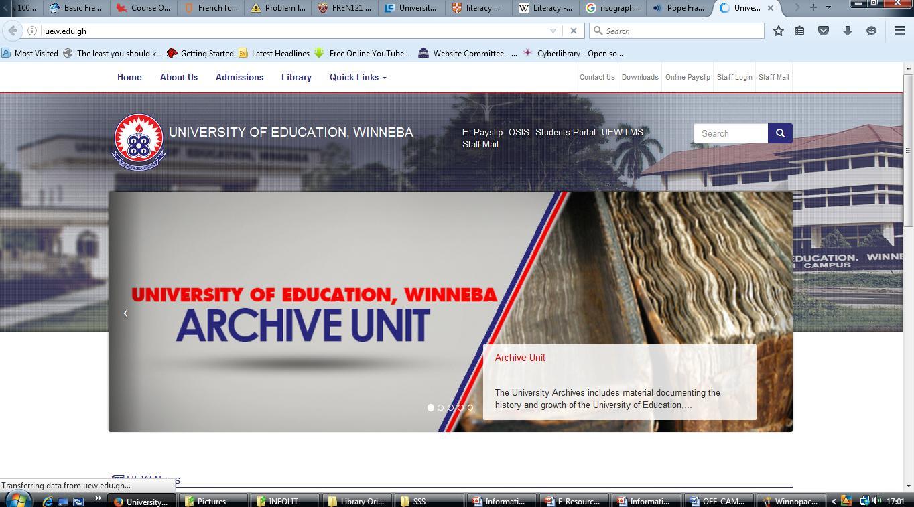
HOW TO GET TO WINNOPAC Go to the University Website www.uew.edu.gh and click on Library

Slide 78
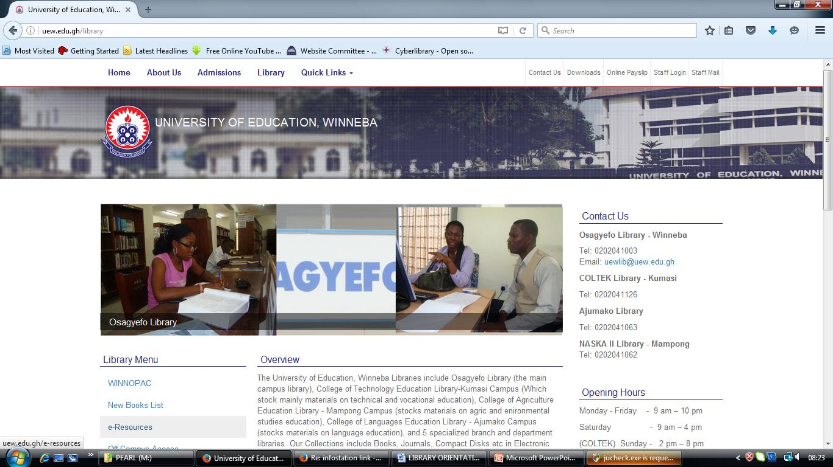
From the Library’s Homepage, click “WINNOPAC”

Slide 79
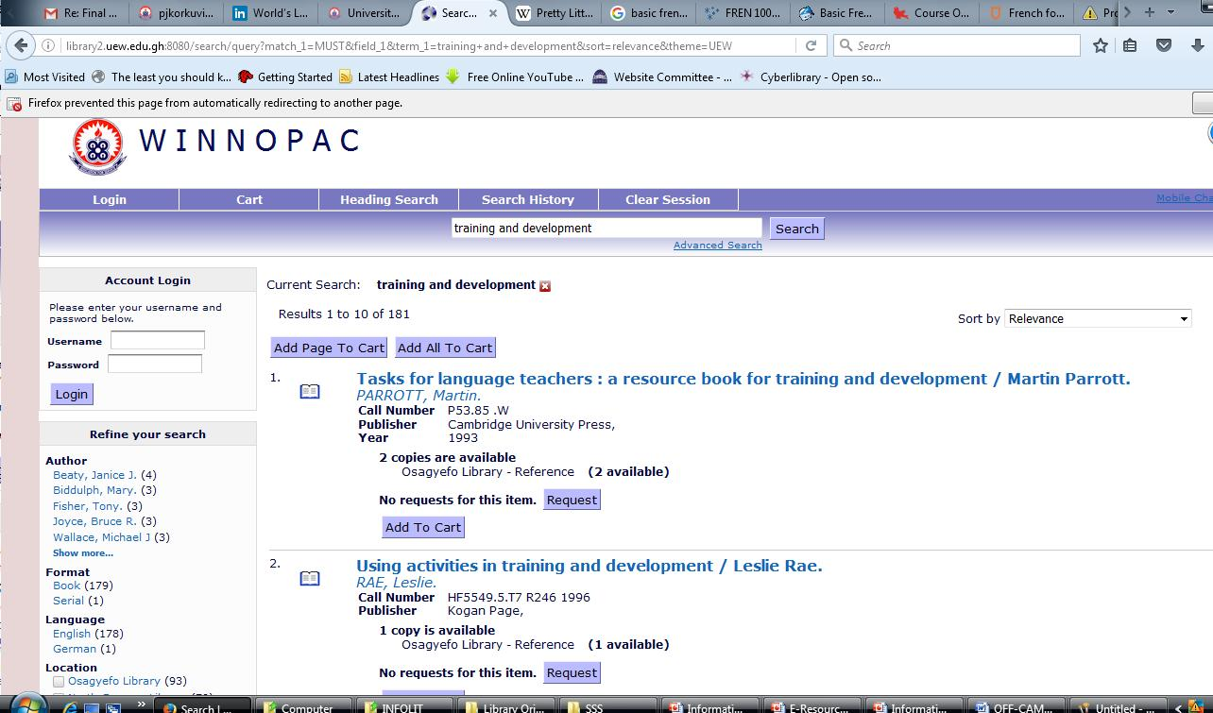
This will then take you to the WINNOPAC or type in the URL: http://library2.uew.edu.gh:8080/search/query?theme=UEW

Slide 80
How to search the WINNOPAC
You can use either QUICK SEARCH, HEADING SEARCH, or ADVANCE SEARCH to search for a book, journal, report etc.
For a known AUTHOR type the Surname.
For a known TITLE, ignore articles such as a, an, the etc at the beginning of the title. For example, to search for the book “An introduction to Education”, type “Introduction to Education” without “An”.

Slide 81
Electronic Information Retrieval
Information can also be accessed from the Internet through the use of tools such as:
Search Engines
The Web
Databases
Social Media

Slide 82
The Internet
The Internet is a high-speed electronic network that connects personal computers and organizational computer facilities around the world.
This network is connected by fiber optics such as telephone lines, cables, and communication satellites.
The Internet is available to anyone with a computer, connection, and the internet service provider, example Vodafone.

Slide 83
The Uniform Resource Locator (URL)
Every Web page has its own address called a Uniform Resource Locator (URL). Much like the address on an envelope with a name, street address, city, state, and zip code, each part of a URL provides information about the Web page.
https://www.uew.edu.gh

Slide 84
The domain name tells you the type of organization sponsoring a page. It is a three-letter code that is part of the URL and preceded by a "dot(.)" Here are the most common domains:
Domain Names
Domain | Description
.edu / .ac | educational institution Even though a page comes from an educational institution, it does not mean the institution endorses the views published by students or faculty members
.com | commercial entity Companies advertise, sell products, and publish annual reports and other company information on the Web. Many online newspapers or journals also have .com names.
.gov | government Federal and state government agencies use the Web to publish legislation, census information, weather data, tax forms and many other documents.
.org | non-profit organization Nonprofit organizations use the Web to promote their causes. These pages are good sources to use when comparing different sides of an issue.
.net | internet service providers
.mil | U.S. military

Slide 85
Search Engines
These are computer programs that search documents for specified keywords and returns a list of documents where the keywords were found.
On the World Wide Web, the search engine utilizes automated robots to gather information and automatically index sites.

Slide 86
Examples of Search Engines
Google Yahoo
Bing Yandex
Alta Vista Ask.com
Dogpile Hotbot
DuckDuckGo

Slide 87
Databases
Databases are collections of digitized information organized for simplified, fast searching and retrieval.
Databases may be full text or bibliographic.
Databases contain scholarly journals, books, reports etc.
They may be general or subject specific.
Databases are updated regularly.

Slide 88
Examples of some Databases
Britannica Online Academic Edition http://www.search.eb.com
EBSCO http://search.epnet.com
Emerald Press http://www.emeraldinsight.com
JSTOR (archive) http://www.jstor.org/logon
Taylor and Francis Online https://www.tandfonline.com

Slide 89
Information Search Strategies
Search strategies are ways of using search terms in finding required information from search tools, such as search engines (Google), the online library catalogue (WINNOPAC) and online databases

Slide 90
Planning a Search Strategy
Plan the next five steps before proceeding with the search.
Identify search terms
Limit the search
Apply Truncation, Wildcards And Phrases
Combine terms using Boolean logic
Combine terms using other connectors

Slide 91
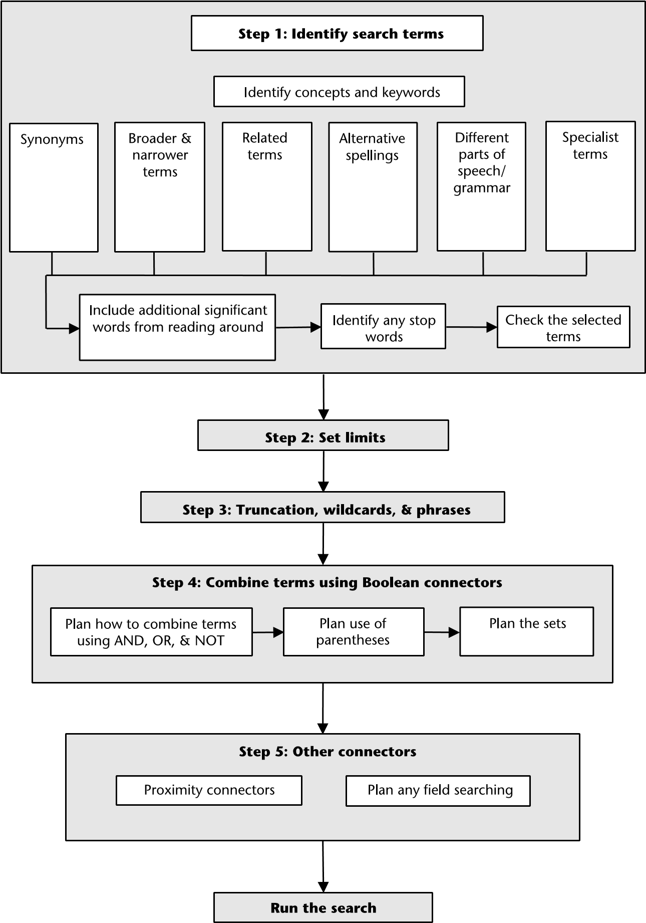
Source: The Five Search Steps (Rumsey, S., 2008)

Slide 92
Strategies for Conducting Academic Searches: Analysis & Synthesis
What is the problem? The problem is the research problem; the reason why you need the information.
Create a research topic out of your research problem. Your assignment topic or project topic may be your research topic.
Re-write your research topic as a research question.
Break main research question into smaller research questions. Try to re-write the questions back into smaller thesis statements.
Finally, create thesis statements out of each research question.
Notes:
Student Activity: In Groups
1. Students brainstorm and give examples of a research problem and break them down into research questions.
2. Conversely, students brainstorm and give examples of a research question and re-write them as thesis statements.

Slide 93
Strategies for Conducting Academic Searches: Create Concept Charts
Keywords are major concept terms.
They are used to match words that are used in already publicly available published/unpublished works.
Garbage in; Garbage out!
Identify your keywords from thesis statement
Develop concept charts out of keywords to identify PREFERRED TERMS (synonyms) and un/related terms
Leave out adwords: articles, prepositions, conjunctions, etc.
Notes:
Student Activities
Students write their thesis statements on board and select keywords.

Slide 94
Strategies for Conducting Academic Searches: Create Search String
Using Boolean operators, create a search string by combining your keywords.
Boolean Operators are AND (+), OR (*), NOT (-)
Do not combine more than three keywords in a single search, such as:
“Climate change” AND food OR crop AND Africa
Keywords can be compound words, hyphenated words, or very short phrases.
The fewer keywords combined, the more relevant your results, the more your results too!
Notes:
Student Activity
Students practice combining their keywords

Slide 95
Boolean Search Strategy
Boolean search is a type of search that allows you to use keywords with operators such as:
AND, OR, NOT
The Boolean operators combine keywords to broaden or narrow search results
They can be used with most search engines, databases, and OPACs

Slide 96
AND
In this search we retrieve records in which both search terms are present.
Use AND to narrow your search and retrieve fewer records.
For example, Exercise AND Health retrieves records containing both keywords.
Exercise 52,600,000
Health 182,000,000
Exercise AND Health 8,490,000
You get fewer results the more terms you combine.

Slide 97
OR
OR Logic is most commonly used to search for synonymous terms or concepts. It collates the results to retrieve all unique records containing either or both of them.
Use OR to broaden your search.
For example, Salary OR Income.
Salary 368,000,000
Income 196,000,000
Salary OR Income 570,000,000
Notes:
memory loss or amnesia or Alzheimer's
aging or aged or elderly, seniors

Slide 98
NOT
In this search we retrieve records with only one of the terms present, the one we have selected with our search.
For example, Eating Disorders NOT Bulimia. Note that this search shows fewer results for eating disorders NOT bulimia than each term on its own.
Eating disorders 232,000,000
Bulimia 241,000,000
Eating disorders NOT Bulimia 26,600,000

Slide 99
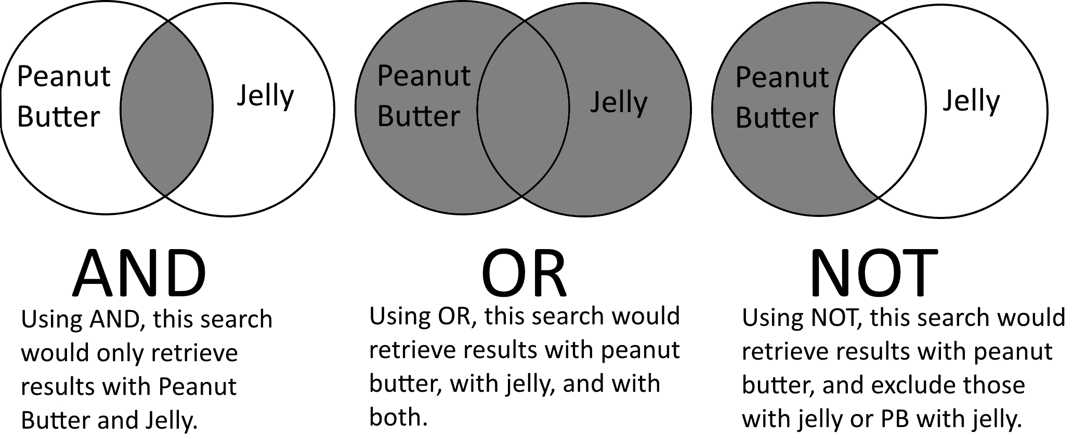
BOOLEAN LOGIC/OPERATORS
Notes:
Boolean operators work like a Venn diagram with words

Slide 100
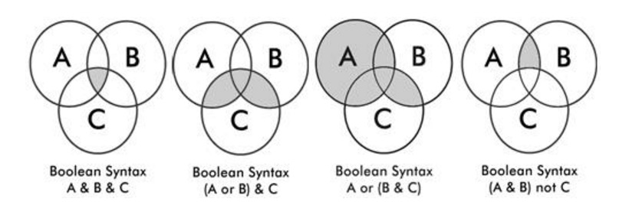
Combining three (3) terms for more complex searches
Notes:
A = “Climate Change”
B= “Food Production”
C= Africa

Slide 101
e-Resources of the Library
Online Academic Databases:
Are a web based filing system designed to store academic information. The database can be accessed by Web scripts and are purchased by subscription.
Accessible from a local network or the Internet.
Provides access to online journals
Scholarly or peer-reviewed articles written by experts in academic or professional fields.

Slide 102
e-Resources of the Library
Online Academic Databases:
They are excellent sources for finding out what has been studied or researched on a topic.
To find bibliographies that point to other relevant sources of information.
Example:
EBSCO, Science Direct, Ajol, Emerald, etc.

Slide 103
e-Resources of the Library
Accessing UEW e-Resources
You can access e-resources in two ways:
1. On- Campus access (without password):
Simply ...
Connect to UEW network
Go to http://uew.edu.gh
Click on Library
Click on e-Resources Link

Slide 104
e-Resources of the Library
2. Off- Campus access (with password)
Connect to the internet
Go to http://uew.edu.gh
Click on Library
Click on the Off-Campus Access Link
Login with moodle account
For example:
Username: 6140210214 (Student ID No.)
Password: 313620 (Admission No.)

Slide 105
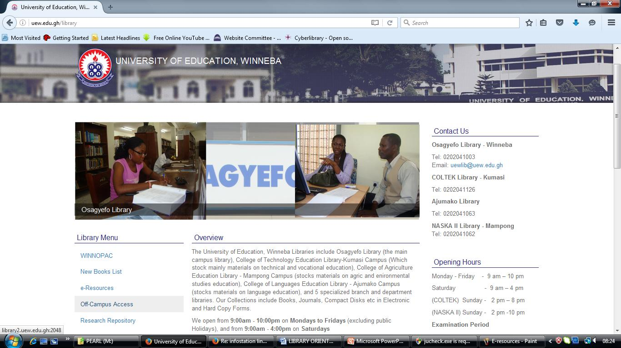
e-Resources of the Library

Slide 106
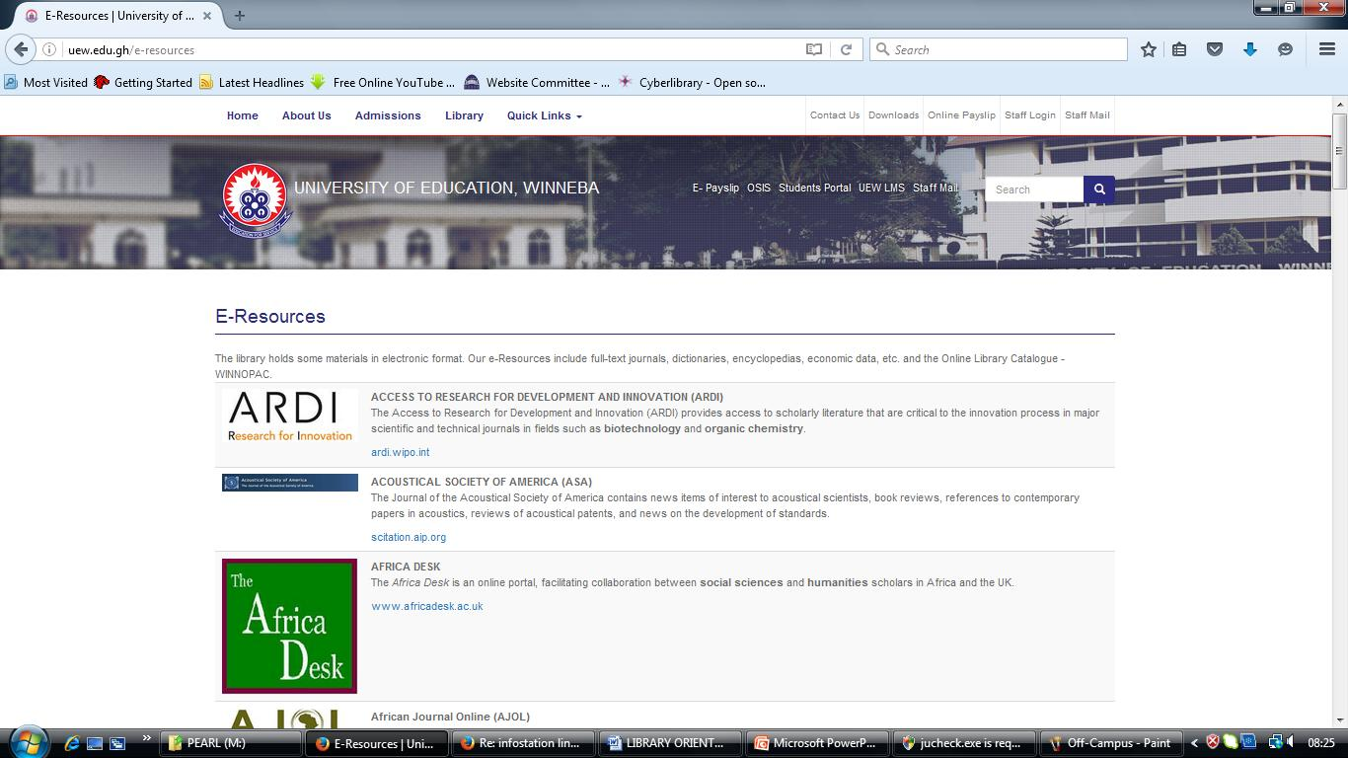
e-Resources of the Library

Slide 107
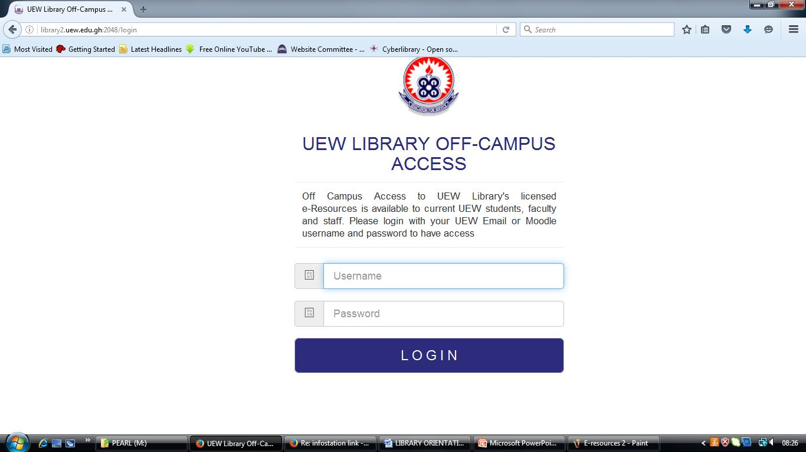
e-Resources of the Library

Slide 108
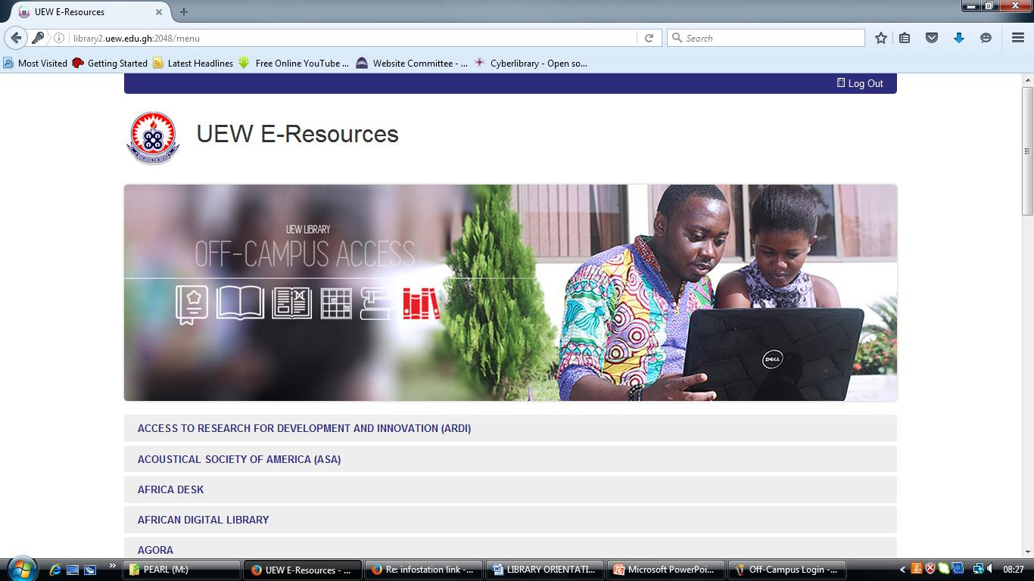
e-Resources of the Library

